Slide 1

Seeds of Hope
Vincentians as Informed Navigators by Linda Alexander
Notes:
My name is Linda Alexander. I am a Vincentian from Mary Mother of God Conference in Oakville, part of the Halton Particular Council (which includes Oakville, Burlington and Milton), a member of the Ontario Rejuvenation team and lead a National project, called Seeds of Hope
I have been a Vincentian since 2010, so in my 15th year of service.
Today I will share our HPC journey of stretching our roles past transactional charity towards relational ministry, bringing our neighbours and their precious children hope and opportunities for a healthier and more sustainable future.
We will learn how to mature our roles as Informed Navigators, referring and connecting and walking alongside our neighbours in need to programs under the 3 pillars of Health, Education and Wellness (HEW).
We can be the link from awareness to access. First the member is aware, then we can make our neighbour aware, and most importantly we can walk alongside them to access.
Would love for you to introduce yourself, where you are located and how many years you have been a Vincentian.

Slide 2
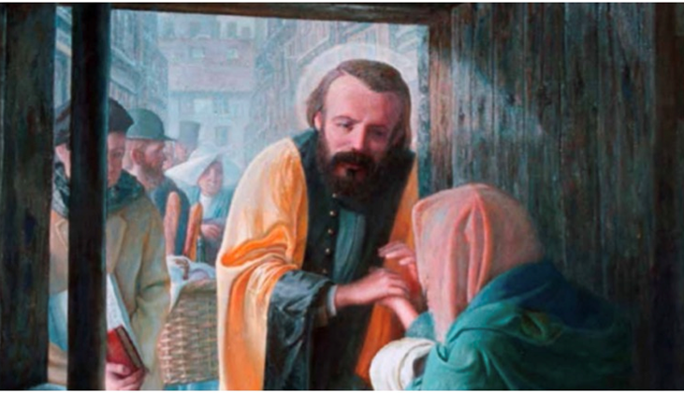
Journey from Transactional Charity
to Relational Ministry
“Do not be afraid of new beginnings.
Be creative. Be inventive.
Organize new works for love in the service of the poor.
You who have energy; Who have enthusiasm;
Who want to do something of value for the future;
Be inventive, launch out; do not wait.”
Blessed Frederic Ozanam
1833
Notes:
You want to make a difference, encourage and empower the families and help in an impactful way.
Keep going back to the first visit to a family in Paris Blessed Frederic Ozanam addressed firstly the immediate needs of a young mother and then with careful listening, conversation and strategizing he used his knowledge, contacts, training, experience and qualifications to place the woman on better footing for her future and the future of her children.
How exciting and fulfilling this must have been helping to transform this woman’s life like this.
Meaningful relationships and fruitful interactions with the families and with fellow members
It is task orientated service, faith fueled action and turning concern into action.
I heard this from a fellow Vincentian – SSVP is a verb!
This is what BFO started and we need to continue to work together to re-align and find our way back to our charism.

Slide 3
Families are worth it, lets bring them hope
“There are two causes of exclusion. Financial poverty and information poverty.” Nicholas Barr
Notes:
Families are worth it, lets bring them hope.
How do we view the families we serve. Do we know them? Do we know their story. Do we take time to see Jesus in them?
We have the time and the bandwidth to be able to become informed navigators so that we can walk alongside the families to a healthier and more sustainable condition.
What do I mean by informed navigators? It means that I am interested to find out what I need to know to be able to pass on this knowledge in a way that will ensure the family benefits and then to walk beside them or telephone with them.
It means I help navigate from the start to the finish.
There are so many barriers for the families to access the resources and opportunities that are out there and sometimes we struggle to navigate them ourselves.
With a bit of time and interest we can learn more about what is out there through our own investigation and through learning from other Vincentians.
The quote from Nicholas Barr sticks in my head and reminds me that sometimes it is just too overwhelming for the families to find out, let alone access, the resources that will help them.
There are 2 causes of exclusion. Financial poverty and information poverty’ Nicholas Barr.

Slide 4
By seeing our roles differently as ‘informed navigators’, we can start to help in all possible ways
Notes:
By seeing our roles as informed navigators we can start to help in all possible ways.
We can be the link from awareness to access.
We can encourage, nudge, support them to access.
First the member is aware, then they make the family aware and then they walk alongside the families to access. and towards a healthier and more sustainable condition
Our goal can be to help them move out and stay out of poverty
Knowledge is power and we’ just don’t know what we don’t know’
Imagine if we could unleash the skills and talents and knowledge that we have as a team, what an impactful benefit we could offer to the families.
By becoming aware of local resources we can develop our roles as informed navigators.
Since there is so much out there and our families are struggling to benefit from the resources, it is important that we start to view our roles as Informed navigators.
This makes our jobs a little more challenging but much more rewarding.
When a new member joins SSVP we include basic local resources with our orientation so that the members are equipped to know and be aware of what is available for the families.
When we first welcome a family to SSVP who have asked for help we leave them with some basic information so that they can access resources and ask us for more help next time we see them.
We provide a folder of key resources during the new family welcome visit.
We also send them an email with a link to all the resources that we have mentioned in the visit, so they can research and follow up.
As informed navigators we are not only using our bandwidth to be informed for the families, we are using our God given gifts and talents to pass on to the families, so that they can move to a better and more sustainable condition.
Our goal is to embed this type of knowledge and conversation into all our home visits and family interactions at the fresh food box distribution day for example.

Slide 5

Becoming more informed
about resources, programs and opportunities
Notes:
Starting off with becoming more informed…Lets look at three aspects of this:
Firstly why is this even needed?
Secondly what is the basic information we can be aware of?
And lastly, lets be sure to know what is free and subsidized in the areas of Health, Education and Wellbeing.
It is hard even for us to figure out what the opportunities and programs are that available for us and our children.
There are such so many. New ones get created, existing ones get improved.
For somebody struggling in poverty, its much harder to navigate resources and opportunities
This is especially true for those living with a disability
We can focus on building awareness of other outreach, programs, opportunities and services in the local area.
This is so key - know your community resources. Know your government benefits - regional, Ontario, Federal
Empowering the families to connect to programs, especially those that will connect them to their skills, strengths and dreams
We continue to stretch the vision towards a Relational Ministry of Accompaniment
In Halton, we have organized them under the pillars of Health, Education and Wellness (HEW).

Slide 6
Build your Resource Toolbox
Notes:
What should be in our resource toolbox?
We include such resources as Where to find help in Halton, where to find food in Halton. 211, 311 - key numbers, Halton Community legal Clinic. Halton Multicultural Council.
Include information on the Prosper Canada benefits finder.
A resource binder which includes information about all the key resources in the community is essential to create.
I read a great term from Donna Beegle from Communication across barriers, who is a leading poverty activist in the US – build your resource backpack.
Each of the members by being inquisitive and curious can share with the team the resources they have uncovered.
We meet with the key agencies and create collaborative relationships with them.
Learn from the internet, the local newspaper, look out for and research opportunities that can help the families.
To help them build the capacity of the families to success by creating a pathway to access and to motivate, encourage and empower them to take advantage of the opportunities.

Slide 7
Being prepared to take that extra step to refer and help navigate
Notes:
We are going to talk about what our Society asks us to do
What it looks like to take that extra care and why we should even bother with this extra step.
When we take the extra step we can ensure that the families are actually connecting to the opportunities that they are now aware of.
We need to work to remove the poverty barriers and create opportunities to move out of poverty. It is moving beyond assisting our neighbours to cope while they continue to live in poverty to helping them to move out of poverty
The systems are so complex that navigating through barriers to access is hard even for us and we are in a comfortable place and with adequate if not abundant means.
It seems like a maze to some and they don’t know where to start. The issues faced by the families become so complicated and entwined that they get worse and the worse they get, the less likely a person will be able and ready to tackle the very first step.
There are so many hoops and barriers.
Language barriers
Literacy issues
Learning disabilities
Forms to drop off but no car. Forms to sign but no printer.
School assignments to do but no laptop.
No home support for a sick child.
No funds to fix a broken car
The barriers and challenges can go on and on
With a bit of time and interest we can learn more about what is out there through our own investigation and through learning from other Vincentians.

Slide 8

…and help in all possible ways
Notes:
This is part of our mission statement– to help in all possible ways
To be the link from awareness to access. First the volunteer is aware, then we can make the family aware, and then we can walk alongside them to access.
As our mission and values state that we should be prepared to have personal contact with those in need and to help in all possible ways.
What does this mean?
What is possible?
What is possible for you is different for what is possible for those we serve. It is highly likely that we have greater bandwidth to spend time solving problems. We know trouble shooting can take time and means record keeping and follow up efforts. What is possible for us as Vincentians and what is possible for our conferences?
If we can figure out what is possible we will figure out how to reach our potential. That is all that is asked of us. To do our very best as Vincentians.
Everyone has problems and issues they are trying to struggle through and our SSVP families are no exception.
We are always going to come across barriers to moving forward and staying vibrant as many people do not like changing what they have always done.
We are about finding solutions to problems.
If we find a barrier we go over it, or we go under it or we go around it, with the help of the learning from the families and with the help of our fellow Vincentians we hope we can come together as a family and reach our potential to better serve the families.

Slide 9

Reach our potential
Notes:
We can continue to strive to reach our potential to assist.
We are the Catholic church, we have the largest recruiting base of any outreach organization. We are only tapping our potential to help.
We are Prayerful Positive people of possibilities (PPPOP)!
We can build the resource and financial capabilities to help our neighbours in a meaningful impactful way
We have the privilege of stepping into people’s lives in home visits, building trust and learning how we can assist the families to move forward to a more sustainable and healthier condition.
We can continue to keep stretching past transactional charity to relational ministry.

Slide 10

Journey from Transactions to Trusting Relationships
HELPING IN ALL POSSIBLE WAYS
Food
Food Cards
Help with Basic Needs
Food Pantry
Safety
Fresh Food Box
Basic Needs
Regular Contact
Back to School Program
Unexpected Household Expenses
Budget Stretching Annual Expenses
Thanksgiving Program
Christmas Program
Building Trust
Medical Needs and Dental Care
Health
Barriers to Education
Barriers to Emotional Well-Being
Education
Recreation
Solving Problems
Past-Due Utilities
Rent Arrears and Eviction
More Bills than Income
High Debt Load
Government Housing
Utility Programs
Debt Rescue Program
Deepening Trust
Health Issues
Physical/ Mental
Fatigue and Despair
Low Confidence
No Support
BRIDGING THE GAP
INFORMED NAVIGATORS
Notes:
This is a visual of how HPC is working to help in all possible ways. And to keep stretching the work we do. With each level, we are going deeper in how we are able to assist.
With the luxury of bandwidth a member of Society of Saint Vincent de Paul can become informed and be a voice for those whose bandwidth has become so restricted by the iron cage of poverty.
For each of the many problems that are faced there are programs, opportunities, resources out there. Once we are aware, we can make the neighbour aware but we don’t stop there.
We make sure they are connected and are able to see it through even if SSVP contributes financially to ensure the outcome.
Once we have built up our confidence we can share what we know. The learning will always continue and we must be willing to absorb and adapt and find out more if required. We see a need, we respond to a need. We accompany.

Slide 11
We have found active projects to be a means to help
the families better and to attract new member who
wish to use their skills to make a difference
Need
Pilot
Expansion
Toolkit
Coaching
Notes:
We have found active projects to be a means to helps families better and to attract new members who wish to use their skills to make a difference.
We have incubated a number of social justice projects at our conference at MMOG
The projects have followed a trajectory of spreading throughout Halton, to Ontario region and then to National
We have invested time in creating toolkits so we can capture our lessons learned over the last 10 years and so the toolkits can be used for training purposes.
A lot of the heavy lifting has been done.
The foundation is in place.
There is coaching and support available.
There is a path that has been created that you can step into.
The social justice projects are serving as effective engagement vehicles for new members.
And the projects are serving for effective engagement and retention vehicles.
Active conferences are attractive conferences.

Slide 12
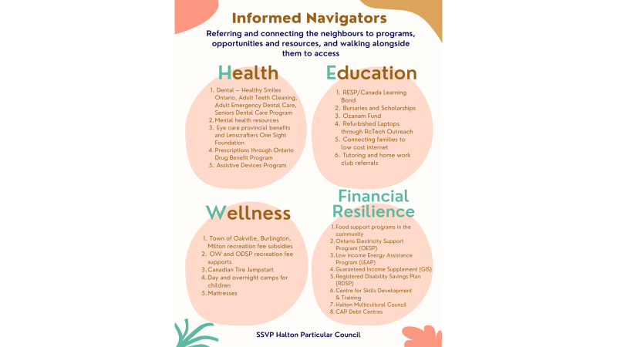
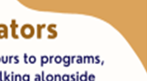
Health, Education and Wellness (HEW)
Informed Navigators
Referring and connecting the neighbours to programs, opportunities and resources, and walking alongside them to access:
Health
Education
Dental – Healthy Smiles Ontario, Adult Teeth Cleaning, Adult Emergency Dental Care, Seniors Dental Care Program
Mental Health resources
Eye Care provincial benefits and Lenscrafters One Sight Foundation
Prescriptions through Ontario Drug Benefit Program
Assistive Devices Program
RESP/Canada Learning Bond
Bursaries and Scholarships
Ozanam Fund
Refurbished Laptops through RcTech Outreach
Connecting families to low cost internet
Tutoring and homework club referrals
Wellness
Financial Resilience
Town of Oakville, Burlington, Milton recreation fee subsidies
OW and ODSP recreation fee supports
Canadian Tire Jumpstart
Day and overnight camps for children
Mattresses
Food support programs in the community
Ontario Electricity Support Program (OESP)
Low Income Energy Assistance Program (LEAP)
Guaranteed Income Supplement (GIS)
Registered Disability Savings Plan (RDSP)
Centre for Skills Development & Training
Halton Multicultural Council
CAP Debt Centres
Notes:
This is a visual index of the various programs, opportunities and services we are aware of and that we can assist the families in getting access to
We are encouraging everyone to develop their own resource activation strategy/rhythm.
I will share our strategy. As part of the new family welcome visit, we include a copy of the key resource information sheets. We send a follow up email outlining the resources, with a brief explanation of the services, a link to the website, the phone number. Then they can save the email and keep referring to it.
Our home visits and food box events always have a resource focus. At our food box event, we have a resource table. We always showcase 1 or 2 resources per event. We have a wellness call team in place and they will reinforce the resources that were recently showcased. Repetition and dialogue will help increase the access to the resources.
In Halton we participate monthly in a meeting with a large group of service providers in the community that is organized by a Social Worker with the Halton Region Police Services Community Mobilization Bureau. Participants are Halton Community Legal services, Halton Healthcare, social workers from both school boards and many more organizations.
Find a similar collaborative body in your community and join it. The relationships, connections and information you will receive are invaluable on getting as informed as possible. The more informed your team is the more they will be able to assist.

Slide 13

Informed Navigators
At each Social Justice Meeting, the resources will be reviewed and recapped to make the information concise and easy to share with members and neighbours.
How to Share with Members
Member Meetings:
The first step is to familiarize your members with the information by sharing the featured resource at your conference meeting.
Discuss the triggers that make that resource important at that time of year and the consequences if your neighbours are not aware of the resource – e.g. paying for formula when they can get it free at the foodbank, formula is expensive (explain how much it costs relative to the grocery assistance you give them).
2) Success Stories:
Share a success story when a neighbour utilized that resource.
Add the resource sheet to your meeting minutes along with the direct link to the website where it is posted.
How to Share with Neighbours
1) Home Visits:
Resource Sheet – Bring the along the Resource Sheet with you on a home visit and start a conversation with the neighbour about this new resource you just learned about.
Highlight New Information – “Did you know the food bank is now offering frozen halal chicken?” Pick a fact that will resonate with that particular neighbour – “Did you know you can get formula for free?”
2) Events:
Info Table – If you are hosting an event, have an information table with members nearby to talk up the resources.
Listen to Learn – Be positive and listen to what the neighbour says; often they know of new community resources. Listen for barriers to access and think of ways the team can help to remove them.
Conversation Starters – Have items on hand to start a conversation e.g. set up a dental table with toothbrushes, toothpaste and dental floss to set the stage for a dental conversation.
3) Food/Program Deliveries:
Drop-0ffs – When dropping off a food card or making a food delivery, bring along a resource page that is relevant to the neighbour.
Help Overcome Barriers – Engage in a conversation, explaining the opportunity and the steps to access. Ask for permission in following up with them in a month’s time to see if they encountered any barriers to access.
4) Targeted Emails/Calls:
Wellness Calls – If your team does wellness calls, create a script to help members effectively discuss a particular resource with the neighbours. Send an email blast when it is an easy resource to understand and access – e.g. list of local food resources with locations and times.
New Neighbour Welcome - After completing a new neighbour welcome visit, send a follow-up email outlining the resources that were shared in the visit, with a brief description of the resource, a link to the organization’s website and contact information.
Notes:
The following slides include strategies to activate the role of Informed Navigators
It includes tips on how to share resources with the members and how to share them with the neighbours
It is part of the Social Justice - Access to Resources training module from Halton Particular Council

Slide 14
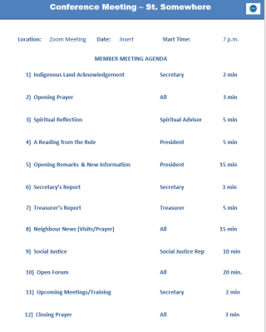


How Conference Presidents Can Help
1) Put Social Justice As A Recurring Agenda Item At Conference Meetings
Have ‘Social Justice’ as a recurring agenda item at every conference meeting.
Ask your Social Justice Representative to share the information from the most recent Social Justice Meeting.
In advance of the conference meeting, discuss which tips for sharing resources with neighbours suggested at the Social Justice Meeting and/or ones of your own, will be presented to the members. Encourage all members to share any new information about resources they discover on their own.
Consider having an action item as an outcome. For example, you might agree to have a Food Flyer handed out with every food card/voucher during the months of January and February.
2) Meet Regularly With Your Social Justice Representative
Whether you connect by phone, zoom or in person, spending 10-15 minutes each month with your Social Justice Representative will benefit both your neighbours and your members.
At each Social Justice Meeting they will gain deeper knowledge about timely resources to help neighbours and will be eager to share ways to get these resources to them.
Together you can discuss what will work best for your conference and what your Social Justice Representative will present to your team.
Meeting regularly also lets them know you value their contribution and consider Social Justice to be a priority at your conference.
3) Recruit And Engage Members Into Social Justice Roles
Use the Social Justice Projects such as Seeds of Hope, North of 60 and the National Housing Campaign as recruitment tools to attract new and existing members. Sharing that SSVP is involved in these projects will attract people with aligned skills.
Recruiting for specialized roles such as a RESP/CLB or Dental Champion will free capacity for your Social Justice Representative and engage new or existing members to deepen their commitment to SSVP and helping neighbours in need.
Consider incorporating information about these projects and Social Justice roles into pulpit and recruitment appeals.
Social Justice
Championing Social Justice
Notes:
This slide includes tips on how the conference can help create a Social Justice – Access to resources culture
It includes suggestions to include Social Justice as an agenda item at conference meetings, meet regularly with the Social Justice rep and recruit and engage members into the Social Justice role

Slide 15
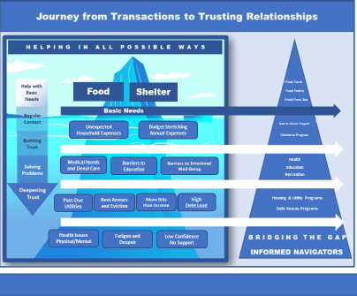

How Conference Presidents Can Help
4) Stretch Beyond The Immediate Need:
Incorporate resources into regular day-to-day support such as home visits and food card/voucher drop offs.
Provide information about resources at as many interactions points with neighbours as possible. For example, if you have a Fresh Food Box or Pantry, have resource brochures on display and/or packed with items you are providing to neighbours.
A resource is more likely to be used by a neighbour if it is timely. For example, including a brochure with information about Tax Clinics along with a food card in March is more likely to resonate and be used by a neighbour.
It is also important not to overwhelm neighbours with too much information by providing several brochures which may never get read.
When meeting with a neighbour consider handing out supplies such as a toothbrush and toothpaste as a conversation starter about dental health.
5) Add Information About Resources To New Neighbour/Member Welcome Packages:
When you welcome a new neighbour, consider including a resource folder with the information you provide to them.
Keep the information in the folder to a few, high impact resources such as the Resource Recap and Food Flyer to increase the likelihood your neighbour will read through the information provided.
Consider giving the folder to new members to inform them about resources and make them aware of the information being provided to neighbours.
You may want to follow up with both neighbours and members to see if they have any questions about the resources you highlighted in the folder.
If you do not hand out a folder, consider sending an email outlining any of the resources you discussed with a new neighbour with a link to the service provider so the neighbour will have easy access to research and learn more about the opportunity.
6) Use Social Justice Meetings As Training Tools:
While Social Justice Meetings are for Social Justice Representatives, every member of your conference are welcome to attend.
At every meeting, new resources are highlighted and on a rotating basis different resources are explained in detail. It is a great learning opportunity for any member who is interested in helping neighbours get accesses to resources.
Learning about resources may also appeal to new members who have aligned skill sets. For example, a teacher or banker may be interested in learning more about how we help neighbours get access to RESP/CLBs.
= Transformation
Championing Social Justice
Notes:
Keep stretching beyond the immediate needs, add information about resources to the neighbour welcome visit and the new member orientation process, use Social Justice cross conference meetings as a training vehicle

Slide 16
Tips to Keep a Focus on Social Justice
1) Meet Regularly With Your President To Discuss How To Share Information About Resources
Ask your President to include ‘Social Justice’ as a recurring agenda item at every conference meeting.
In advance of a conference meeting, review with the president the information and action items from the past Social Justice meeting. Together determine the topics to share with the conference members.
Present the topics at the meeting. Encourage members to share any new resources they have come across. Members will gain knowledge about timely resources to help neighbours and will be eager to share ways to get these resources to them.
Consider having an action item as an outcome. For example, the team might agree to have a Food Flyer handed out with every food card/voucher during the months of January and February.
Whether you connect by phone, zoom or in person, spending 10-15 minutes each month with your president will benefit both your neighbours and your members as you work together to remove barriers to access to resources.
Meeting regularly also helps you understand the needs of your conference and get feedback about how your efforts are making a positive impact to neighbours and members.
2) Help Recruit And Engage Members Into Social Justice Roles
Use the Social Justice Projects such as Seeds of Hope, North of 60 and the National Housing Campaign as recruitment tools to attract new members. Sharing that SSVP is involved in these projects will engage people with aligned skills.
Recruiting for specialized roles such as a RESP/CLB or Dental Champion will free capacity for you and encourage new or existing members to deepen their commitment to SSVP and helping neighbours in need.
Ask your president to consider incorporating information about these projects and Social Justice roles into pulpit and recruitment appeals.
Social Justice
Championing Social Justice
Notes:
These slides are tips for the Social Justice rep. Meet regularly with the president, recruit and engage members into the social justice roles

Slide 17


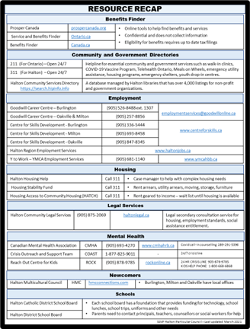
Tips to Keep a Focus on Social Justice
3) Stretch Beyond The Immediate Need:
Discuss with your president how resources could be incorporated into day-to-day support such as home visits and food card/voucher drop-offs.
Provide information about resources at as many interactions points as possible. For example, if you have a Fresh Food Box or Pantry, have resource brochures on display and/or packed with items you are providing to neighbours.
A resource is more likely to be used by a neighbour if it is timely. For example, it would be appropriate to include a brochure regarding Tax Clinics during March interactions.
It is important not to overwhelm neighbours with too many resources at one time.
When meeting with a neighbour consider handing out supplies such as a toothbrush and toothpaste as a conversation starter about dental health.
4) Add a Resource Folder To New Neighbour/Member Welcome Packages:
Discuss with your president how a resource folder might be included with the new neighbour and new member information packages.
Keep the information in the new neighbour folder to a few, high impact resources, such as the Resource Recap and Food Flyer.
You may want to follow up with both neighbours and members to see if they have any questions about the resources you included in the folder.
Consider sending the neighbour an email with a link to the service providers.
5) Encourage Members to Join You At Social Justice Meetings:
While Social Justice Meetings are intended for Social Justice Representatives, every member of your conference is welcome to attend.
New resources will be highlighted and discussed in depth at every meeting. The meetings will serve as an excellent learning opportunity for any member interested in helping neighbours gain accesses to resources.
This may appeal to new members who have aligned skill sets. For example, a teacher or banker may be interested in learning more about how we help neighbours access RESP/CLBs.
= TRANSFORMATION
Notes:
Strategies to keep stretching past the immediate needs, add resources, encourage other members to join the cross conference Social Justice meeting

Slide 18
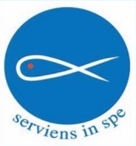
New Neighbour Welcome Model Overview
  Step 1: Welcome: Empathy & Addressing Urgent Needs
  Step 2: Understanding: Understanding Circumstances & Needs
  Step 3: Create the Plan
  Step 4: Walking Alongside: Creating Plan & Accessing Resources
Notes:
This is an example of the steps Mary Mother of God conference in Oakville uses to welcome in a new neighbour
There are 4 steps - the welcome, the understanding, creating a plan, and walking alongside

Slide 19





New Neighbour Welcome Model Overview
The four steps outline a process of building trust, understanding needs, and providing support to neighbours in challenging situations. The emphasis on empathy, understanding, and collaboration prioritizes our neighbour's well-being and empowerment and creates a rewarding relationship for the SSVP member and neighbour.
Understand their story & needs
2
1
Empathy & Urgent Needs
Mapping their needs to resources and creating a plan
3
4
Walking alongside our neighbours as they connect to resources
Equip & Empower our Neighbours
Notes:
Here is a pictorial overview of the model

Slide 20
Step 1 - Initial Visit: Empathy & Urgent Needs
This is an initial in home visit where we assess and provide for urgent needs (most likely food vouchers) and provide empathy and encouragement. Key activities include:
Provide for immediate needs (e.g., food)
Share New Neighbour welcome information, along with key community resources
Leave step 2 New Neighbour Welcome Form to the neighbour to fill out for the step 2 visit
  New Neighbour Welcome Form will collect address, email, phone number, names and ages of each resident, and collection some high level financial information so we can start to uncover opportunities for us to help

Slide 21
Step 2 – Second Visit: Understand their Story & Needs
This is a more in depth visit, where we can understand their circumstances and needs and begin to offer referrals. One member leads the Step 2 visit process and invites other members to participate so more members can get experience with the Step 2 visit. Key activities include:
We review the form and understand more of their story (what they are willing/wish to share) and understand how to better help them
Follow up with an email outlining all of the various programs, opportunities and services.
  We fully understand that the amount of information that is shared is overwhelming (even for Vincentians) and unless we can spend time walking alongside, many of the resources will not be activated.
  Sample of the follow up email on next page

Slide 22
Example Email
1) CRA - call CRA to get your My Account reinstated, so you can access your 2023 Notice of Assessment (NOA). You can also let them know that you are currently not working, on ODSP receiving $1495/month with rent of $1,000. Let them know that withholding your Child Care Benefit and tax refunds is a hardship for your family and you would like some relief from this. Ask them what they can do to assist with this.
2) Student Loans - call the National Student Loan Service and let them know that you are currently not working, on ODSP receiving $1495/month with rent of $1,000. Ask them what they can do to assist with this. Their contact info is: https://www.csnpe-nslsc.canada.ca/en/home
3) Food
a) Fareshare Food Bank - They are open Monday from 9:30-2 pm and Thursday from 2-6:45pm at 1240 Speers Rd - between 3rd and 4th line. Ph 905-847-3988. They have fresh meat &amp; veggies, shampoo, laundry detergent , etc.. Once you are registered, you can expect a phone call from Lorraine who has agreed to do your food picks from Fareshare. She will need you to sign a consent form and fill out the monthly food selection. Their website link is: https://oakvillefoodbank.com/food-help/
b) Kerr Street Mission - have a food bank, Neighbour Care Centre (financial and budgeting assistance), Excellent Christmas program, Kids Club, Summer Programs, Youth Drop-in, Meal Programs and more. We left you with the instructions on how to start the registration process with them. They will also do your income taxes for free. Their website link is : https://www.kerrstreet.com/family/
c) Oak Park Neighbourhood Centre - they have food available but you must be registered. You will need your 2023 NOA, bank statements, etc. to register. They have many programs they can help you with such as free income tax help, signing up for ReConnect and Affordable Access through the Town of Oakville. Their link is: https://opnc.ca/oak-park-fall-fair/
4) Resume and interview help and Job listings at:
a) Goodwill Employment Centre - 2387 Trafalgar Rd near Dundas in Winners Mall phone # is Phone: (905) 257-8856 Open Mon-Fri 8:30am to 4:30pm.
b) Centre for Employment Skills Ontario: https://www.centreforskills.ca/employment-services
c) Employment Halton -https://www.haltonjobs.ca/
d) Sheridan College - Community Employment. Link is : https://www.sheridancollege.ca/about/community-employment
e) Halton Connects - see attached flyer
5) Safetynet - 166 South Service Rd. Phone 905-845-7233 Open Mon-Fri 9:30 am to 1pm. Offers free clothing including coats, footwear, diapers, household items &amp; bikes (If they have any, they were charging $20/bike).Please let us know when you have your appointment with Safetynet. Website link is: https://www.safetynetservices.ca/ Furniture - you can view their furniture by clicking on the word Link in orange at: https://www.safetynetservices.ca/furniture-service There is a delivery fee of $200 for Furniture arranged from Safetynet.
6) Activities for your family:
Oakville Library: your closest location is the Sixteen Mile Branch Library 3250 Neyagawa - on Neyagawa across from the Fortino&#39;s mall on Dundas. That is the drop off for the Oakville Transit On Demand Bus Hub. It would be about a 6 minute walk from the Fortino&#39;s mall. They have an amazing adult &amp; children&#39;s sections as well as many online resources for ebooks/games/movies. Library cards are free but you will need ID with an Oakville address to obtain a permanent card. Link is: https://opl.ca/Library-Services/Borrowing/Get-a-Card
YMCA - I believe you have access to some of the programs with the YMCA for both yourself and your daughter for free. Contact your ODSP caseworker for more info. YMCA programs include activities such as swimming, rock wall climbing, etc. More details are at this
link: https://ymcaofoakville.org/programs/

Slide 23
Example Email
7) You are also signed up for the monthly Fresh Fruit and Vegetable program which you pick up from the Mary Mother of God church side door at 2745 North Ridge Trail, on the 1st Tuesday of the month. Our next Food Box is Dec 3 from 2:00-3:30 to 5:30-7pm. We normally supplement the food box with milk, cheese and eggs if we have sufficient funds. Come in person and meet everyone - grab a snack - grab some dental supplies - sign up for raffle prizes &amp; more. Cellphone # 289-300-1023 if you are unable to come.
8) CLEO: Community Legal Education has many pamphlets on your rights as a tenant/employment/Family law/Immigration and more. You can research pamphlets and free information at this link: https://www.cleo.on.ca/en/resources-and-publications/housing-law
9) Front Line Outreach - offers food support and more if you are signed up with them. They also have a new Moms &amp; Tots program that you and your daughter might be interested in. Link is: https://www.frontlineoutreach.ca/
10) Halton Community Legal Services - they provide legal help for free on housing issues and more. Their website is : https://www.haltonlegal.ca/
11) Oakville Transit free for those aged 0-19 and 65+ with a Presto Card - You can go to a Shoppers Drug Mart (closest one is at Dundas &amp; Neyagawa at 478 Dundas St W on the other side of Dundas from the Fortino&#39;s mall) to purchase one for $4. You will need to take photo ID (passport or birth certificate) with proof of age when purchasing the card. Presto card info can be found at: https://www.oakvilletransit.ca/fares/presto/ You can also use the Presto card on the Go Train. https://www.oakvilletransit.ca/youth-seniors-ride-free.html
We also talked about the Oakville Split Pass program. This is a monthly pass with unlimited bus use. You still would need to pay for it. The regular monthly pass currently costs $143/month of which if you apply for a split pass will cost half that amount. You will need your 2023 Notice of Assessment to apply online. However, your ODSP caseworker may be able to do this for you. Current single use bus fares are: Link is: https://www.halton.ca/For-Residents/Employment-and-Financial-Assistance/Subsidized-Passes-for-Low-Income-Transit-(SPLIT)
12) Affordable Access - You can apply for programs through the Oakville Parks &amp; Recreation Program. You can apply for this yourself or through Oak Park Neighbourhood Centre. If you qualify, you will be given $300 on an IRIS account to use towards camps, fitness - anything in the Parks &amp; Rec brochure. You will need your 2023 Notice of Assessment when applying. Links are: https://www.oakville.ca/parks-recreation-culture/programs-
activities/affordable-access/ and https://opnc.ca/
13) Low cost Internet/phone/TV - we left you with a flyer today from Rogers on low cost phones/internet &amp; TV. Link is: https://www.rogers.com/connected-for-success Since you are on ODSP, you would qualify. Application link is: https://www.rogers.com/connected-for-
success/eligibility-and-application
14) HipInfo - search for any services, food banks, etc. in Oakville. Link is: https://newcomers.hipinfo.ca/
15) Dial 211 or 311 for non-emergency help. 211 gives you any info you need to know on Ontario government services (Health related). 311 gives you
info on Halton related items like how to find a family doctor, housing, etc.. 811 is for Health Care Navigation &amp; Information.
16) dial 811 on your phone - to obtain free confidential mental health advice for you or your children

Slide 24
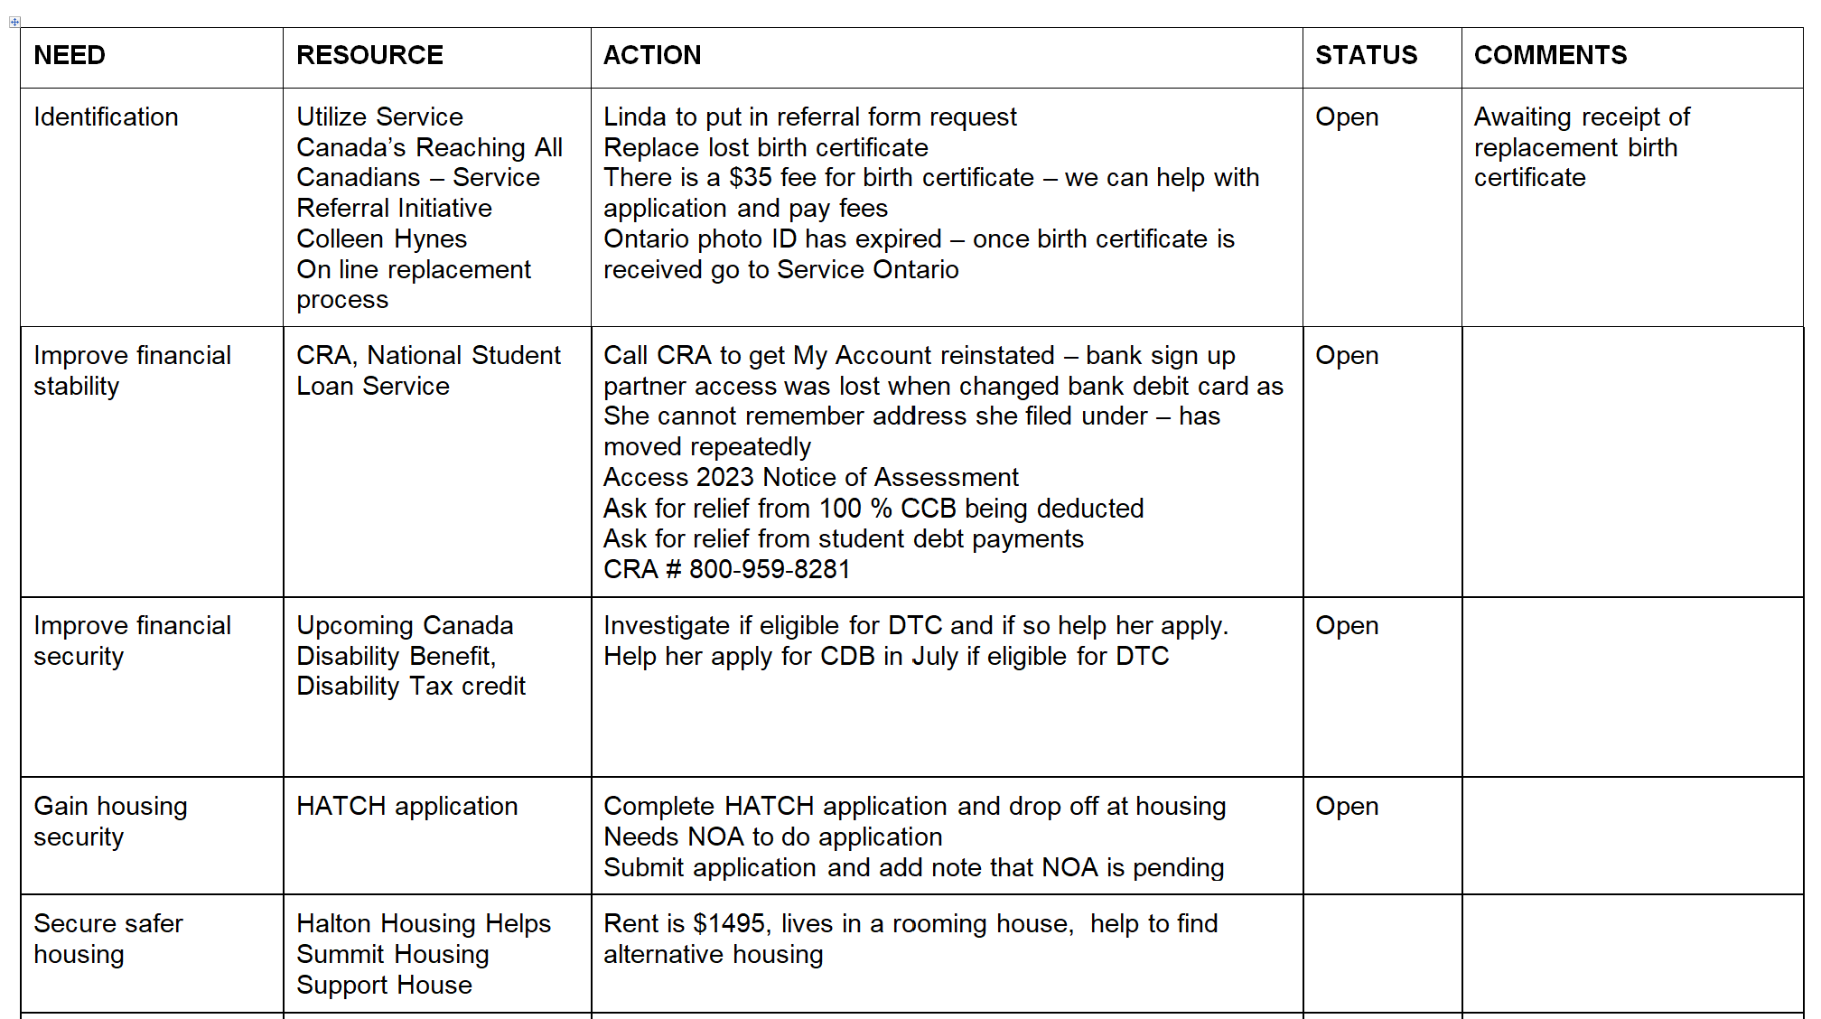
Step 3 – Create the Plan
Based on what we learned about the needs of the neighbour we create a workplan of key activities. See below for an example:
Notes:
A plan is created and 2 members meet regularly with the neighbour to problem solve each issue

Slide 25
Step 4 – Ongoing: Equip & Empower our Neighbours
This is the stage where we help them action items that will bring more sustainable longer term help for them. It’s important we action these one by one and not overwhelm the neighbour. Key activities include:
Have 2 members meet weekly with the neighbour to problem solve the issues and connect the neighbour to resources.
This step of ongoing engagement with the neighbours also helps us deepen the connection of our members to our Vincentian vocation
Notes:
The regular, consistent visits is key

Slide 26



3 Impactful Themes
Dental
Canada Learning Bond
Recreation
Notes:
Three social justice projects that are most impactful are the Canada Learning Bond, Dental Assistance and Recreation.
Seeds of Hope projects provide a wide cross section of opportunities for families to reach into existing free programs for children.
In Halton we have just recently helped the 534th child to open an RESP for their education savings, and receiving the Canada Learning Bond - $2000 of free federal funds , greatly increasing educational outcomes after high school by creating an educational identity early on an creating much needed hope for a brighter educational future (drawing in just over $ 1 million in available federal funds) 6 out of 10 children are still missing out. For those we serve the number is much lower. Vincentians can change that.
We help to increase access to Healthy Smiles Ontario dental coverage and the Canada Dental Care Plan for children 17 and under, ensuring dental health before they lose their benefits at age 18. There is nothing more heartbreaking than visiting with a family with an 18 year old with $5,000 of dental needs now out of reach.
In the past two years have helped over 30 people with unmet dental needs.
We are connecting families and their children with recreational opportunities and programs.
Recreational opportunities is connecting to Jumpstart (up to $ 600), Regional funds (up to $800) and municipal funds ($300), so that is up to $1700 every single year for every single child. These are Halton numbers but many areas have even more generous subsidies. The families are an informed and encouraging conversation away from access.
None of these activities we would not do for our own children and families.
We have toolkits and training and coaching support to help you also launch these projects.

Slide 27




SEEDS OF HOPE
RESP / Canada Learning Bond/
Canada Education Savings Grant Program
Notes:
Thank you so much for the opportunity to present the Seeds of Hope project to you.
Our journey from transactional to relational started with the RESP/CLB initiative and keep spreading further.
Every child deserves hope for a brighter educational future. No child left behind! This is our motto.
We want the precious children we serve to have to the same opportunities and hope for their futures that our own children and grandchildren have.
The children we serve are less likely to graduate from high school, less likely to go on to post secondary.
Almost half of the children are still missing out on the Canada Learning Bond (also known as the CLB), which is $2,000 of free money from the federal government.
The lower the families’ income, the less likely the access.
Vincentians can change that
We read about the Canada Learning Bond opportunity in an article in the Toronto Star way back in 2010.
Helping children get access started at MMOG conference in Oakville, it grew to the other conferences in Halton, then spread to Ontario and because a national project – under the name Seeds of Hope in 2018.
The stats are if there is any money saved for post secondary it greatly increases the likelihood that a child will go on after high school as it creates the hope and expectation that this will be their educational journey.
In this presentation we will explain how Vincentians can help the children we serve get much needed hope for a brighter educational future
Our Society to date has helped approximately 1105 children to date get access to up to $2.2 million dollars in education hope.
It my dream that in time we can collectively assist 2,000 precious children.

Slide 28
The Canada Learning Bond
Hope for
the future
For every child that we serve
Up to $2000 per child
Notes:
The Canada Learning Bond is $2000 of free funds from the federal government into an opened Registered Education Savings Plan (RESP) for every family that SSVP serves.
Vincentians can be the link from awareness to access for this hope.
And this is very empowering for the parents, as they are the ones who create this opportunity for their children.
All it takes is for an informed and encouraging dialogue to raise awareness and a Vincentian to walk alongside the family to access.

Slide 29
Canada Learning Bond Eligibility
Age 20 years or younger
born January 2004 or later
Low Income $53,359 or less
net family income Income eligibility increases with number of children
Valid Social Insurance Number
(SIN for parent and each child)
Notes:
The funds are available for every single child we serve that is now 20 years old or younger. If they were born after January 1, 2004 they are eligible. That is when the program started. If there were born December 31, 2003 as an example, they are not eligible. Only if they were after born January 1, 2004.
The eligibility is net family income of $55,867 so every family we serve is eligible..
The income eligibility amount increases with number of children and the amounts are increased annually.
Number of children (1-3) less than $55,867, (4) $63,036 (5) $70,234 (6) $77,433 (7) $84,631 (8) $91,829
The parent and child needs a Social Insurance number. They can access this through Service Canada, can apply on line, or apply over the phone.
When students reach the age of 18 (the age of majority in Ontario_ , they can open up an RESP on their own as an Adult Beneficiary and get access to the CLB, if their parents haven’t managed to get them access yet.
They can open up an RESP as an adult beneficiary up to the day before they turn 21
In BC however and for other provinces where the age of majority is 19 (B.C., New Brunswick, Newfoundland and Labrador, Northwest Territories, Nova Scotia, Nunavut and Yukon Territories) most banks currently will not allow an 18 year old to open an RESP. So far the only exception is Scotiabank who will allow an 18 year old to open an RESP, with RBC proposing to make this change in 2024.
For banks with this policy constraint due to the age of majority issue, an 18 year old is still allowed to open an RESP and can do so with a trusted adult, who can act on their behalf.
This will be like a guaranteed ‘bursary’ for every student!

Slide 30

CANADA LEARNING BOND
FEATURES
$0
  No contribution required
  Retroactive
  Can only be used for education after high school
Max. $2000
Min. $500
Notes:
So the bond is up $2,000, no contribution is required, the funds can be received retroactively and can only be used for education after high school.
They receive $ 500 year 1 and $100 every year until it reaches $2,000 when they are 15.
The grant is retroactive which means that when an eligible family applies for the Bond their first deposit will include the initial $500 as well as $100 for each previous year the child was eligible.
For example, if the child is 14 and the family has always been income eligible for the past 14 years, within 65 days of opening up the RESP, they will receive $1900 into the RESP.
It covers Full or part time studies in college, university, apprenticeship program or trade school
I always use this language as some automatically think – university – oh that is not for my child, so want to make sure they understand the range of studies it covers and that their child can participate
A key talking point is that these are the children’s funds, they are named as the beneficiary, so if they receive any other government benefits, these benefits are not impacted at all.
The parent is the subscriber, the child is the beneficiary.

Slide 31


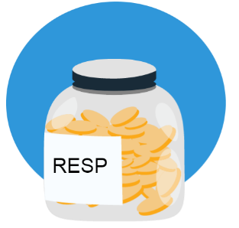
CANADA
EDUCATION SAVINGS
PROGRAM
Canada Education Savings Grant
Family Contributions
Canada Learning Bond
Notes:
The money jar is a key visual to use for both members and for families as some people continue to struggle with this basic concept.
Registered Education Savings Plans (RESP) is the tax – sheltered account required to receive any of the federal or provincial benefits associated with educations savings.
Think of this as a special bank account. A special bank account just to collect funds for post secondary education.
There are 2 sources of funds.
The 1st source is The Canada Learning Bond (CLB) which is the free money or a kick start contribution by the federal government into the RESP of children from lower income families
No parental contributions are needed. Not even one penny
The Bond can only be used for post-secondary education. If a child doesn't attend post-secondary, the Learning Bond money is returned to the government and any contributions a family might have made to the RESP are returned to them.
However, they don't have to go right after high school and have lots of time to make that decision.
An RESP account can be kept open for up to 36 years.
The Canada Learning Bond is an incredible opportunity for parents to get savings started even if they have no money of their own to contribute.
Canada Education Savings Grant (CESG) is a matching incentive designed to encourage contribution to an RESP
We also know that once an RESP account is open and parents start receiving the Learning Bond, most find ways to add to those savings on their own, even though they didn't have to.
The statistics shows that even though no contributions are needed, in over 90% of the accounts, additional funds are being deposited
The CLB is only for the specific child named in the RESP. When the student has enrolled in post secondary, they show proof of enrollment and can withdraw the funds. If the funds are not used at the end of the 36 year time frame, they go back to the government.
If a family has more than 1 child, they have a choice of whether to open up a separate RESP account for each child, or open up 1 RESP and have all of the children’s names in the one account. It is up to them, whatever is administratively easier for them to manage.
Any contributions that are made into the RESP and any Canada Education Savings Grant monies received as a match to the donation can be shared among the children. CLB funds cannot be shared, but CESG funds can be shared.

Slide 32
CANADA EDUCATION SAVINGS GRANT
$55,867- $111,773
$111,773
< $55,359
40%
30%
20%
lower family income = bigger match
Notes:
There are 2 grants - The Basic Canada Education Savings Grant (20%) and the Additional Canada Education Savings Grant (up to an additional 20%) – which is on the 1st $500 contributed
These are matching grants, the government adds more money to an RESP when a family contributes their own money.
Everyone who starts an RESP, regardless of income is eligible for some matching money, but the Federal government provides a bigger match, the lower the family’s income.
For example, for every $100 that a family contributes to an RESP, the government will deposit an extra:
$40 (40% match) if the family’s net income is $55,867 or less and so on
($30 (30% match) if the family’s net income is more than $55,867 but not more than $111,773)
($20 (20% match) if the family’s net income is more than $111,773)
These figures are indexed upward every year.
And it doesn’t matter who contributes. If a grandparent or a friend wants to contribute to a child’s education savings, the matching incentive is still added.
The amount of the matching incentive is based on the income level of the child’s parent or primary caregiver.
There are restrictions for CESG eligibility for children aged 16 and 17. To be eligible, they must meet at least one of these 2 conditions before the end of the calendar year they turn 15 . At least $2,000 is contributed to the RESP (this doesn’t include the CLB contribution), or a minimum annual contribution of $ 100 is made to the RESP in any 4 previous years.
One thing to note – there are annual limits to the amount the government will match - Maximum of $500 per year of grants, so $2,500 max contribution per year. The Additional CESG (ACESG) applies to the first $500 contributes to those income eligible
There is a life time grant limit of $7,200 in matching grants per child. Maximum that can be contributed to RESP is $50,000 lifetime)
This information only applies to residents of British Columbia.
This extra grant is available to residents of British Columbia and is in addition to the Canada Learning Bond.
The British Columbia Training & Education Savings Grant (BCTESG) is a $1,200 grant that is deposited into an RESP.
The parent can apply for the grant the day the child turns 6 and the last day to apply is the day before the child turns 9.
The $1,200 BCTESG is paid in full, in one lump sum, when the RESP is opened and the grant is applied for. It is not income tested, but the family must be a resident of British Columbia in order to be eligible.

Slide 33

CLB Example – Ashley’s Family
Adam – age 12 $1,700
Susan – age 9 $1,400
Kyle – age 5 $1,000
Jack – age 18 mths $ 600
Total $8,000
Notes:
For Ashley, a fictitious SSVP family, there is up to $2000 for each child, so $8,000 of hope.
The funds are deposited $500 in year 1 and $100 every year until it reaches the $2,000 at age 15. The funds are deposited retroactively as long as family was income eligible every year. Adam ($1,700), Susan ($1,400), Kyle ($1,000), Jack ($600) Total of $4,700 in retroactive deposits.
And once the RESP account is open, some SSVP conferences will add a contribution cheque. Contribution amounts may vary between conferences but to use a $100 per child example, that will be another $400. And then the government will add another 40 % or $160.
So an informed conversation and some gently nudging and encouraging can lead to over $8,500 for this family.
And these funds will grow with interest until the students are ready to withdraw the funds when they apply to post secondary.
And there are also bursaries and scholarships we can help the students to access once they are ready to apply for post secondary. Every year there are almost $180 million in funds, with close to $5m going unclaimed.
This is beyond the scope of this presentation, but we do have bursary and scholarship toolkit and a handy one page fact sheet that we can provide to the families with students who are ready to apply for post secondary

Slide 34

WHAT DOES A PARENT NEED TO DO?
❶
Have Social Insurance Numbers for parent and each child
❷
Make an appointment with their bank to open:
  a no-fee, no contribution Registered Education Savings Plan
Note - For newcomers, they
need to wait until they are eligible and receiving the Canada Child Benefit.
GO GET YOUR CHILD’S MONEY
Notes:
The parent and child must have a Social Insurance Number. If they don’t have a SIN #, they will need to go to Service Canada.
They need to make an appointment with their financial institution (where they do their banking) and open up a no-fee, no contribution, Registered Education Savings Plan.
They can make the appointment using the bank’s on line appointment scheduler.
For newcomers, they must first be eligible to receive the Canada Child Benefit before they are eligible for this benefit.
We can still plant the seed that the benefit is waiting for them after they start receiving the CCB.
The family must have their tax filings up to date. As with all other benefits, if their taxes are not up to date, they will not get the benefits to which they are entitled.

Slide 35


Barriers to Access
❷ Misconceptions about RESP accounts
❶ Awareness
❸ Fear the funds may impact other federal or provincial benefits
❹ Intimidation
Many are intimidated by going into a financial institution
BMO and RBC can open up RESP accounts remotely
exempt as assets
exempt as income
Many families are not aware of this opportunity.
The family can open:
a no fee account
no initial contribution
no monthly commitment
We can help to remove the barriers and increase access!
A critical success factor is for one volunteer per conference to step forward.
Conference CLB Champion
Notes:
Many families are not aware of the opportunity. Or they have heard about the opportunity or read about it, but they need to have a dialogue about it to really understand the opportunity and the steps to access.
The government sends out information about the CLB with the Canada Child Benefit notifications, they periodically send out targeted letters to parents whose children haven’t gotten access yet, some school boards are actively promoting the opportunity.
It needs a dialogue and that is where Vincentians can play a key role.
Vincentians can be the link from awareness to access.
There are misconceptions about RESP Accounts. Some think they need to contribute money. They don’t. The family can open up a no fee account with no initial contribution needed and no monthly commitment needed
They don’t even have to put in one penny in to be able to access the funds.
Many are afraid the funds may impact other provincial or federal benefits. The funds are exempt as assets, exempt as income. Opening an RESP does not affect provincial or federal benefits in any province. RESP benefits like the Canada Learning Bond are considered asset and income exempt for the purpose of any social assistance.
They may be suspicious of the opportunity so we position the dialogue by asking first if they receive the Canada Child Benefit. When they say yes, we say oh this is another benefit, you are just missing out on it. Let us help you get the money. They aren’t suspicious of the CCB, so we use this is a dialogue segue to the CLB.
We use the encouraging phrase - Go get your child’s money, It is sitting on the table ready for you to pick it up.
Some may be intimidated by going to the bank.
Encourage them to go with a friend, a sister, a mom. It is always easier to do things together.
Again this is where Vincentians can play a key role.
We can help them to make an appointment on line, we can meet with the bank close to the housing complex and get the name of a contact they can ask to meet with, ( a strong personal referral always works well) we can meet them at the bank for the appointment to set up the RESP.
When they are at the bank, we encourage them to follow the KISS principle. Keep is simple silly! Do not let the bank complicate the process. They want to open up a no fee, no contribution, basic RESP.
They will be asked how they want to invest the funds that will be deposited. Again we encourage them to keep this very simple. With the bankers guidance, to choose a very low risk, simple investment choice that suits their financial situation and their level of investment knowledge (which in most cases is very minimal).
If they have more than 1 child they will be asked if they want to open a family account (and all the children are listed as beneficiaries on the 1 account) or if they want to open a separate RESP for each child. This decision is up to the family and its their decision, but they may find with having only 1 account it is much easier for them to administer. And the CESG funds can be shared between children. CLB funded can not be shared between children.
Again, always best to follow the KISS principle.

Slide 36

Join us
Our kids need YOU!
Become a CLB Champion
Notes:
We can help to remove the barriers and increase access!
A critical success factor is for 1 or 2 members per conference to step forward to lead this.
All the team members need to be aware of the opportunity. Those who have the initial interaction with the family makes them aware and then refers them to the SOH Champion who will walk alongside them and nudge them through the steps to access
Imbed the CLB dialogue into the various touch points with the families. Provide the CLB one page fact sheet at the new family welcome visit, on a home visit, at the monthly food box.
At MMOG for instance, at our monthly food box, we have a Trifold display at the SOH table, resources on hand, CLB champions standing at the table ready to engage in conversation
We note any follow up nudging support that may be needed.
On our new family welcome process we make the families aware of the opportunity so the seed of information is planted.
Then we refer the families with children 18 and under to the SOH Champions who will make the calls and do the follow up work to nudge encourage and support them until access.
I don’t want this to sound more complicated than it is. This is about making the families aware of the opportunity and encouraging them to make an appointment and go to the bank to open up the RESP.
If you have opened up an RESP for your own child or grandchildren, it is the same process to follow.

Slide 37
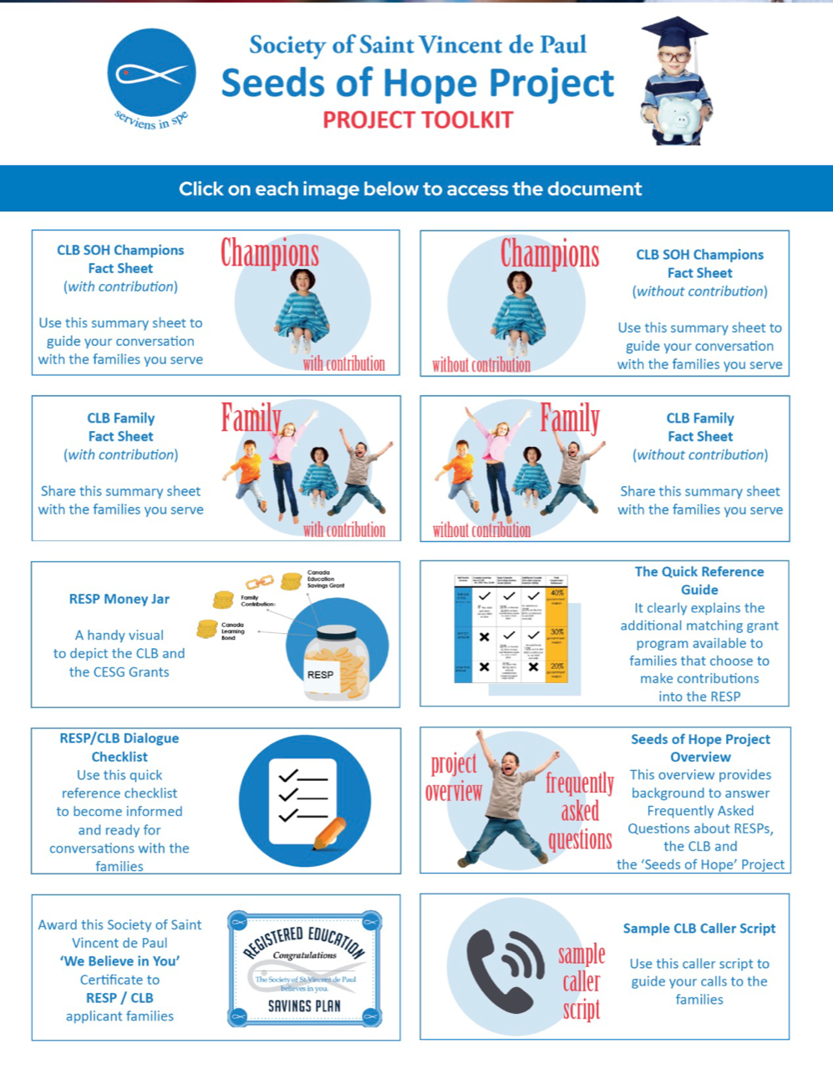

https://ssvp.ca/special-projects/seeds-of-hope/seeds-of-hope-toolkit/
Hope for the future
Notes:
We have a toolkit on the National website with all of the information a Champion and the members will need.
One on one coaching is available.
There is a one page fact sheet for the members and for the neighbours to help demystify this.
I don’t want to overcomplicate all of this. This is about setting up an appointment to set up a no fee no contribution RESP.
The bank handles everything and the application for the bond and grants gets sent electronically after the RESP is set up.
I have probably talked to over 1,000 families over the last decade and there is most likely not a barrier that I haven’t heard of and have managed to remove.
I would love to share my lessons learned and solutions to help you to help the families you serve.
In Halton, we have just helped our 424th child - our next milestone goal – 450!
The collective National goal is 1000 precious children, up to $ 2 million in educational hope

Slide 38
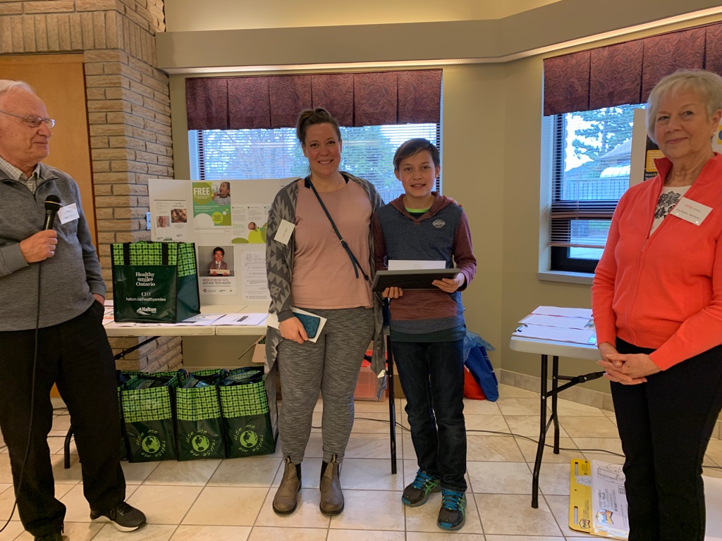
Lets all agree that we can have one of these certificates in each of the children's rooms
Notes:
As part of our SSVP solutions in Halton, we provide a $100 contribution cheque into the RESP, which will attract the 40 % match from the government. You don’t have to add this element to the project. Some councils provide a $50 contribution cheque. Some councils just provide the framed congratulatory certificate if they don’t have funds available.
On the left of the slide you will see a picture of the framed congratulatory certificate we provide to children and along with the contribution cheque.
We put the child’s name and frame it.
It says simply congratulations. We believe in you. The children love the certificates.
On the right of the slide you will see Cori and her son Phoenix who visited our annual gathering of conferences one year.
It was very insightful to hear the impact SSVP has had.
Here is part of what Cori shared with us that day,
SSVP has been a wonderful resource for me emotionally, as well as with food. I’ve been given hugs, a kind ear, words of motivation and encouragement. See I have also been left in tears of joy. SSVP has blessed us at Christmas and helped me with a phone bill.
SSVP and Jay Brown actively pushed me to set up an RESP in order to get access to the Canada Learning Bond for my Son Phoenix. Phoenix is always SO excited when we visit TD and contribute a little more, and he watches that bank statement grow. It’s at 2400 now, by the way. Another thank you
During this meeting our Holy Rosary conference presented Cori and her son with a cheque for his RESP and a certificate for his bedroom wall.
For those conferences without the financial means to contribute, the We believe in you certificate can be provided which is equally powerful in the messaging.
My dream is that this certificate can be hanging on every child’s bedroom wall, bringing them hope.
This is what it is all about, one child at a time. One family at a time.
I will share some work that was done in London with a collaboration between SSVP and the London Community Chaplaincy. We helped the families of a large subsidized housing community at Southdale get access. Pam the chaplain had the great idea that at the annual Christmas party held at the local school to have Santa give out the Congratulatory Certificates to the children.
What an amazing sight to see the children and their parents so excited. And what a powerful message about the hope for the educational future delivered by none other than Santa!

Slide 39
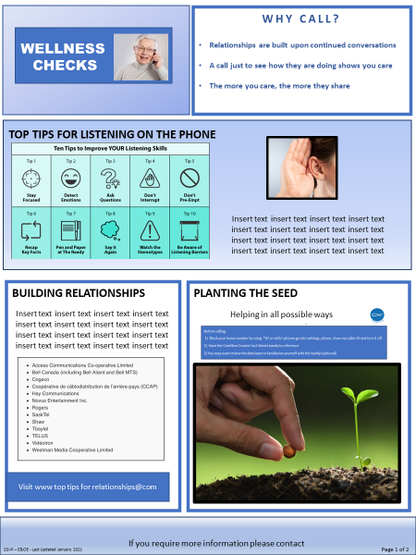

Canada Learning Bond Referrals
Members
plant the seed
Referral made to CLB Champion who:
  Explains the process
  Answers questions and offers encouragement
  Removes barriers to access
Notes:
Members plant the seed at touch points and then refer to the CLB champion for follow up.
The key is to find 1 or 2 members who are passionate about education to lead this. A retired teacher is ideal or any member with a simple desire to bring hope for the children.
If you are organized, persistent and passionate about children and education, you are a perfect fit for the role!
Will you put your hand up to be the SOH champion for your conference or do you know someone passionate about children and education that you can work to recruit and welcome into the ministry ?
The champion would simply need to familiarize themselves with the information contained in the toolkit, identify the CLB age eligible children and then get a plan in place to explain the process to the families, answer questions and offer encouragement and support. Remove any barriers and walk alongside the family to access.
The gentle nudging, encouraging follow up and support is key to helping create access to this opportunity.
It really is about helping one child, one family at a time.
We encourage everyone to just start with one child.
Once you help one child, you will just keep going until all of the children you serve have access
Every child deserves hope for a brighter educational future. No child left behind !

Slide 40
RESP/CLB Script
Page 1 of 2
Introduce yourself and explain reason for the call:
Hello my name is __________and I’m a volunteer at the Society of Saint Vincent de Paul, (insert location). Am I catching you at a good time to have a brief chat?
We are calling families with children under 19 to make sure they know about $2,000 of free government money to help pay for education costs after high school. Half of the children across Canada are still missing out of their education funds and we are calling all of the families we serve to try to make sure that as many children as possible get their funds.
Start the conversation:
Does your child have a Registered Education Savings Plan (RESP) and the Canada Learning Bond (CLB)?
If they answer yes:
Congratulations, that’s wonderful!
Do you remember getting the Canada Learning Bond, it is $500 up front and then $100 every year until deposits reach $2,000.
If they don’t remember if they received the CLB:
As long as your family net income is less than $50,197 and you are receiving the Canada Child Benefit, you should have received the CLB. Check your statements to make sure you received it or contact your bank to make sure they applied for it.
Note – Some families may not have received the CLB due to a bank process error. Or if they applied before they were receiving the Canada Child Benefit (this applies to newcomers) they will not have received it and they need to have their bank re-apply now they are receiving the CCB. They can also call the Canada Education Savings Program hotline at 1-888-276-3624 to inquire. They need to have their child’s SIN# for the call.
If they haven’t already opened up an RESP:
The Canada Learning Bond is up to $2,000 from the government that is deposited directly into an Registered Education Savings Plan (RESP) for your child.
Think of the RESP as a ‘special bank account’ where money can grow until your child is ready to attend college, university, an apprenticeship program or trade school. It can be for full-time or part-time studies.
After your child is enrolled in a post-secondary program, they can start taking out their money from their RESP account.
You do not have to put any money into the RESP to get the CLB – not even one penny.
If you happen to be receiving any government benefits, the CLB will not affect any of those benefits. This is your child’s money for after high school.
It is for children born January 1 2004 or later, whose families are receiving the Canada Child Benefit and whose family’s net annual income is less than $50,197. The family income cut-off is higher for families with more than 3 children.
Tip – Quantify the amount they are eligible for: “You have three children under the age of 19? That means there is $6,000 waiting for them, courtesy of the government.
Is the neighbour getting the Canada Child Benefit (CCB):
If you are getting the benefit, the CLB is another benefit your children are entitled to receive.
The government will deposit $500 into the RESP within 65 days from the time you open the account and then $100 every year until the deposits reach $2,000.
Even if you apply several years after your child was born you will still receive all payments for your child – as long as you were always income eligible over those years. For example, your child is 10? So within 65 days the government will put $1,400 into the RESP account.
Note – If they are newcomers they need to wait until they are eligible to receive the CCB.
Notes:
Additional resources – an RESP/CLB script to use to guide the discussion

Slide 41

RESP/CLB Script
Page 2 of 2
How to apply for the RESP/CLB:
First, does your child have a Social Insurance Number?
IF YES:
The next step will be to contact your financial institution, where you do your banking. Call your bank and ask to make an appointment to set up a no fee, no contribution RESP. The bank will apply for the CLB for you.
You cannot go to a teller to open an RESP, an appointment must be made with a Financial Advisor. You can use the online appointment scheduler to make the appointment or just give them a call. Some banks may be able to open an RESP virtually.
IF NO:
You can apply for the SIN # online at www.canada.ca or visit the Service Canada Offices.
When you go to the bank:
Start the appointment by saying you want to open a no fee, no contribution RESP so you can get access to the CLB.
The bank will ask you to choose the type of investment you want for your RESP account. One of the suggestions will be a Guaranteed Income Certificate (GIC) and there is no risk of losing any money with that type of investment. You may want to stay away from mutual funds as your balance can go up or down, depending on the stock market.
If you have more than one child, you have a choice to open up one RESP account and your children will all be named as beneficiaries in the one account or you can choose to open up a separate RESP for each child. It is simpler to have just one account for all children but that is for you to decide.
Tip – Offer to help them make the bank appointment online for them now. This will get the appointment made and a follow-up email will be sent to the family.
WALKING ALONGSIDE OUR NEIGHBOURS
Some neighbours may consider an appointment at the bank overwhelming and would appreciate you offering to go to the bank with them. If they decline your offer, suggest they bring the one page fact sheet to the bank with them.
RESP Contribution Cheque:
Once you have the RESP account set up, SSVP will contribute a $100 cheque to deposit into the RESP per child. And then the government will match these funds by another $40.
Tip – Put the cheque in a large manila envelope and write 'please deposit the cheque as soon as possible’ on the envelope. They cannot go to a Teller to deposit the cheque as it is going into a registered account, they have to make an appointment to see a Financial Advisor.
Note - When they have opened the RESP, email or text them a copy of the RESP contribution form (if applicable) so the contribution cheque can be created and the ‘We believe in you’ certificate can be produced. You may want to offer to complete the form for them. All you need is the name of their financial institution, the plan number and the name of the beneficiary(s) on the account.
Instructions on how to proceed with the cheque and certificate preparation are in the SOH Toolkit.
Closing the Call:
Do you have any questions?
Do you want me to email you a copy of the CLB flyer that explains what we have been talking through?
Feel free to call me if you have any questions. I am happy to help you make that appointment and go with you to the bank if you wish.
May I call you back in a week’s time or so to see how it is going?

Slide 42
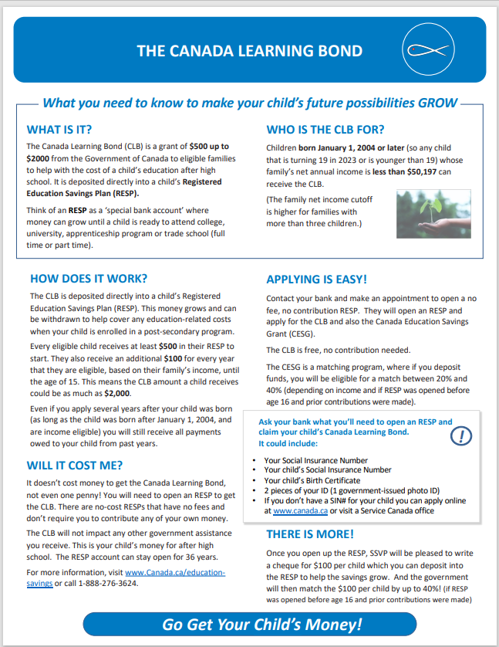
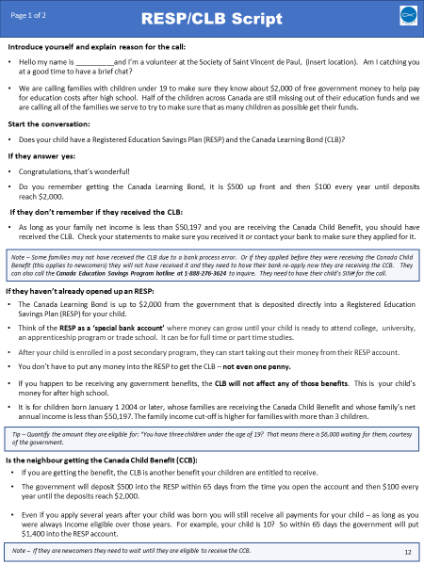
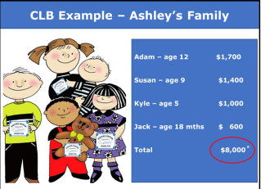
Resource Roadmap
Education – RESP/CLB
Tips for
Sharing with
Members
The following are examples of how you can share the information you learn in the Education training at a Member Meeting:
Review Neighbour Fact Sheet
Provide each member with a copy of the Fact Sheet for neighbours from the Seeds of Hope Toolkit.
Review the fact sheet with them, highlight the features and benefits and how to apply.
Share that neighbours may appreciate an offer to go to the bank with them.
Explain that SSVP provides a $100 deposit for every child’s new RESP (while funding is available).
Visit https://ssvp.ca/special-projects/seeds-of-hope/seeds-of-hope-toolkit/
2) Role Play Call Script
Consider doing a role play, using the scripts in the Education training.
Ask a member to play Ashley, the mother with 4 children and you play the SSVP member trying to help each of her children get an RESP/CLB.
Doing the role play will show how easy the conversation can be and demystify the process of encouraging a parent to get an RESP/CLB.
You may inspire a member to join you in making the calls once they see how easy it is.
The script is available on the national website listed above
3) Share Success Stories
Share success stories from your conference or ones shared at the Social Justice meeting.
Nothing inspires other like hearing how a neighbour feels after getting free government money for her children and the hope she feels for their future.
You could also use the example of the fictitious Mom, Ashley Ackerman, on page 5 of the RESP/CLB Education Training.
Hope for the future
Halton Particular Council
Updated May 2023
Notes:
Suggestions on how to activate the resource

Slide 43
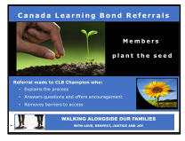
Resource Roadmap
Education – RESP/CLB
Tips for
Sharing with
Neighbours
Do a Call Program
Use the call script and fact sheet to set up a call program, using a list of families with children eligible for an RESP/CLB.
Ask if any members will volunteer to do calls with you and provide them with an overview of the RESP/CLB training.
When making the calls, let neighbours know it is an ideal time to get to the bank to open the RESP/CLB as it is easier to get to the appointment while the kids are in school.
2) Set up Referral Program
Once you develop a list of neighbours who have children who qualify, ask members who have developed a trusting relationship with some of the neighbours on the list to do a warm-up call.
Ask them to plant the seed and let the neighbour know that there is an important benefit called the Canada Learning Bond that they may be missing out on and that someone from your conference will be calling to talk to them about it.
Also ask members to bring up the RESP/CLB, when appropriate, at all interaction points such as home visits, food card drop-offs or when welcoming a new neighbour and ask those neighbours if a member can follow up with a call to discuss it in more detail.
3) Hand out the Fact Sheet at a neighbour event hosted by SSVP
When hosting an event, set up an information table with copies of the Seeds of Hope Fact Sheet.
Have members on hand to give out the fact sheet, start a conversation and answer questions.
You may also want to put a fact sheet in anything being provided to the neighbour (e.g. Fresh Food Box, Back to School package).
You may want to make note of any qualifying families in advance of the event in order to bring it up with them when they do a pick-up (e.g. Fresh Food Box neighbour/food card list).
4) Talk about RESP/CLB at a School or Community Event
Set up a table at schools:
Consider asking your local schools if you can set up a table during one of their events such as JK Registration.
While you are trying to help low-income families, you may be approached by other families. Share the guide that outlines the government matching program which is for all families and all income levels with the percentage increasing for lower income families.
Set up a table at the Food Bank:
Consider asking your local Food Bank if you can set up an info table. Have copies of the fact sheet on hand to give to people visiting the Food Bank.
Hope for the future
Halton Particular Council
Updated May 20203

Slide 44

Dental suffering is hidden but prevalent among all those in poverty and we can help alleviate this by connecting them to dental care
Notes:
Dental suffering is hidden but prevalent among all those in poverty. If you are living in poverty, it is likely that you have an unmet dental need. We can help alleviate this by connecting the families to dental care. And to make sure they are fully availing themselves of any dental benefit coverage they may have.
It was a Christmas wish list in 2012 that alerted us to the needs out there. One mom said, - “all I want for Christmas is my to get my teeth cleaned”.
We witness dental suffering on a daily basis
Despite the reality of every member is dealing with their and their own family’s dental care and dental concerns, efforts to assist our SSVP familles in the same way has been surprisingly low, but we are trying to change this.
We find that the largest barrier to accessing dental care is not lack of benefits, it is dental anxiety/dental phobias that create the larger barrier.
Vincentians walking alongside the neighbours, encouraging and supporting them to seek dental treatment will help reduce dental suffering.
We are encouraged by the federal government’s new Canada Dental Care Plan. The plan covers children under the age of 18, persons living with disabilities with a valid Disability Tax Credit, Seniors aged 65 and over.

Slide 45
Dental coverage programs to help alleviate dental suffering
Healthy Smiles Ontario
Urgent Dental Needs
Senior Dental
Canada Dental Care Plan
Teeth Cleaning
Ontario Disability Support Program
Ontario Works
Notes:
We have a goal in Halton that every conference will be paying attention to dental suffering.
We as SSVP are in an ideal place to take action because we see the families regularly.
We have a 4 pillar approach and you can start with one of these pillars, you do not have to start with four!
This is just an example of how we proceed in Halton and I fully realize dental coverage differs by geographic locations across Canada. This is an illustrative example only,
– Healthy Smiles Ontario, Adult Teeth Cleaning, Adult Urgent care, Senior Dental – this includes connecting seniors to the Ontario Seniors dental care program (OSDCP)
Healthy Smiles is an Ontario program but there are similar programs in other regions.
Start with connecting the children. If we can help the moms become aware of the free dental care, we might be able to ensure that the children get seen regularly by dentists to avoid later major dental pain and suffering due to neglected teeth.
We have a goal to imbed the dental conversation into our home visits so that we can connect the families to the dental care they need for themselves and their children.

Slide 46

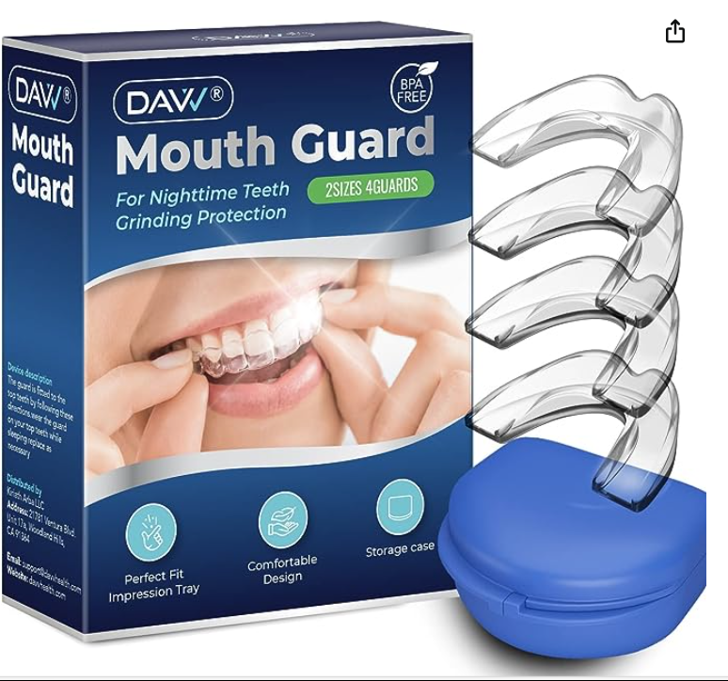
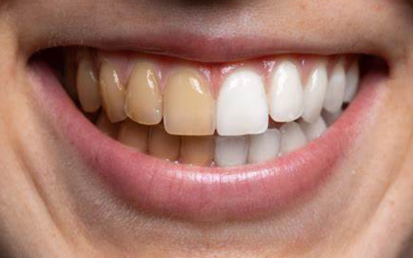
Canadian Dental Care Plan (CDCP)
CDCP is an insurance program that will start covering most basic dentistry costs next year for uninsured Canadians with a household income under $90,000.
The CDCP will help cover the cost of various oral health-care services, with the focus on "those deemed medically necessary by an oral health-care professional," and include:
  Preventive services, including scaling (cleaning), polishing, sealants and fluoride.
  Diagnostic services, including examinations and X-rays.
  Restorative services, including fillings, crowns and dentures.
  Endodontic services, including root canal treatments.
  Prosthodontic services, including complete and partial removable dentures.
  Periodontal services, including deep scaling.
  Oral surgery services, including extractions.
  ​​​​​​
Eligible persons will receive a letter with a personalized application code as well as instructions on how to apply. If there are any questions or concerns advise them to call 1-833-537-4342.
What Is Not Covered
Services such as the following will not be covered:
  Teeth whitening
  Implants and mouth guards
Group | Applications Open
Seniors aged 87 and above | Starting December 2023
Seniors aged 77 to 86 | Starting January 2024
Seniors aged 72 to 76 | Starting February 2024
Seniors aged 70 to 71 | Starting March 2024
Seniors aged 65 to 69 | Starting May 2024
Persons with a valid Disability Tax Credit certificate | Starting June 2024
Children under 18 years old | Starting June 2024
All remaining eligible Canadian residents | Starting 2025
If there is dental coverage through government programs or for Canadian residents who have access to dental coverage through a social program offered by a province or territory and/or the federal government, they can still qualify for the CDCP if they meet all the eligibility criteria. In that case, coverage will be coordinated to ensure no duplication and avoid gaps in oral health care. **Starting July 1st, CDCP patients can seek services from any dentist regardless of whether they have signed up under the CDCP. From this date, any oral health care provider can bill Sun Life directly in order to allow any patient the ability to chose any dentist that fits their needs. **
https://www.canada.ca/en/services/benefits/dental/dental-care-plan.html
Notes:
I will touch briefly on this new and emerging Federal dental care plan.
There is a separate Dental training toolkit if interested in learning more about how to start a dental focus in your council/conference

Slide 47
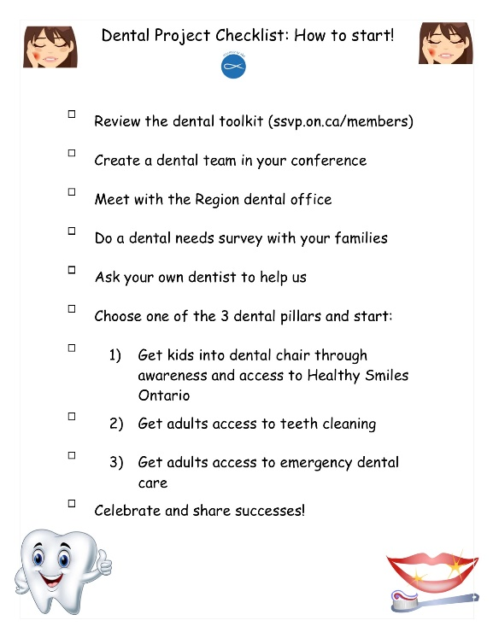
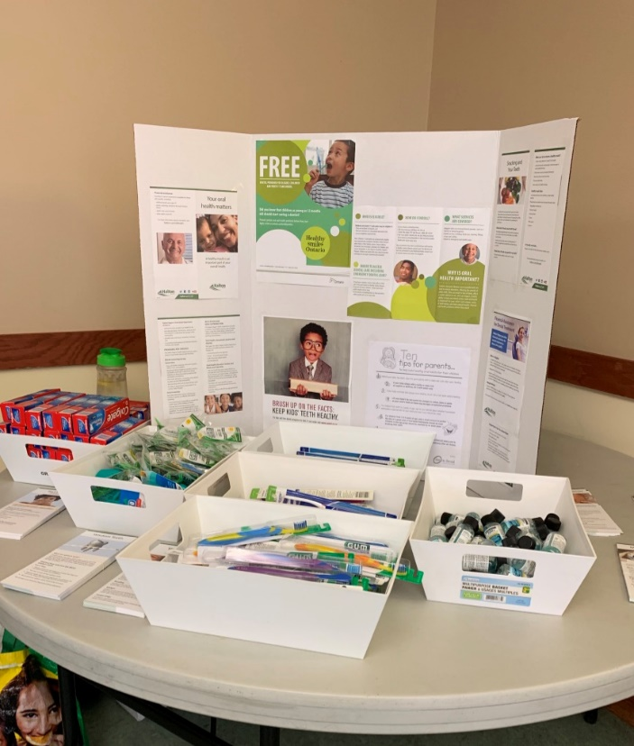

It’s easy to embed this type of learning into your home visits and all your interactions with the families
Notes:
We have prepared everything that could be helpful for you. Whether you are on a home visit or whether your families are coming in to the church for a fresh food box. These conversations can bring to light the issues.
One gentleman had been suffering for four years needing dentures. Awareness led SSVP to connect him to receive dentures and for the first time in four years he was confident enough to smile again.
One 6 year old has never been to the dentist. She suffers from severe anxiety and her mom is worried about how to get her there. With a bit of research we have been able to find a dentist that specializes in these tricky situations where children are too overwhelmed to get into a dentist chair.
The other day a text came in from a mom who had just had her teeth cleaned with SSVP help and she was so happy that her message included numerous emoji’s expressing her excitement and gratitude. It was almost like she had won the lottery.
One senior we know has been feeling sick for years. It took some encouragement and nudging for us to help walk alongside her to ensure that she received the treatment she needed to connect her to a professional who has identified the problem with an damaged crown that has been infecting her mouth and gums on one side of her face, for more than a year. This dental work, she has been told will clear up the infection and make her feel better than she had felt for ages.
This is social justice in action!

Slide 48
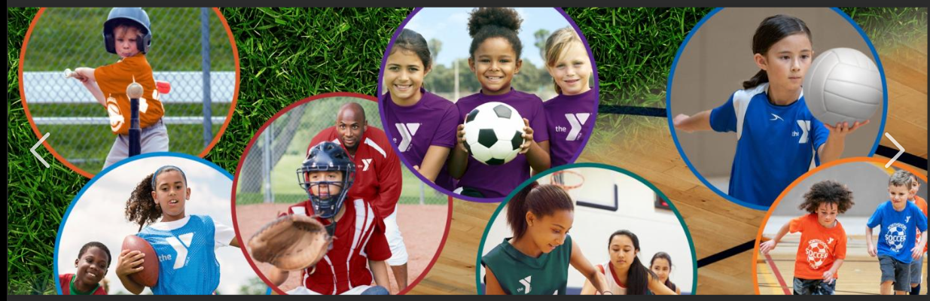
Children need activities that will empower them, help them grow as individuals and give them hope for their own futures
Notes:
We are on a mission to get every child we serve into recreational programs.
Children need to get connected into activities that will empower them, help them get connected into mentors, help them grow and give them hope for the future.
One of the families we walk alongside is a mom with four children under 13. The youngest, let’s call him Daniel, loved the Karate kid movie and watched it all the time and wanted to join Taekwondo. With a bit of time and effort, SSVP members walked the mom through the application process for Jumpstart (this is the Canadian Tire fund available to children nationally) approached the local studio for a discount and helped connect Daniel and his older brother Ricky to Taekwondo. They go five times a week and it’s a home away from home.
We can help to find each child’s spark and help to connect them into recreational programs.

Slide 49



There are programs and financial assistance for all children to be involved in activities and sports
Notes:
There are programs and financial support programs available for each child we serve to be involved in enriching sports and activities.
To monetize the opportunities in Halton just as an example, children are able to access Canadian Tire Jumpstart (up to $600 per year), Regional funds (up to $800 per year), and Municipal funds (up to $300 per year).
That totals up to $1700 of opportunities each and every year for every child we serve. Some regions and municipalities offer even more generous incentives to encourage the children to participate in the community.
Get informed about what is available in your own communities and help to connect the children.

Slide 50
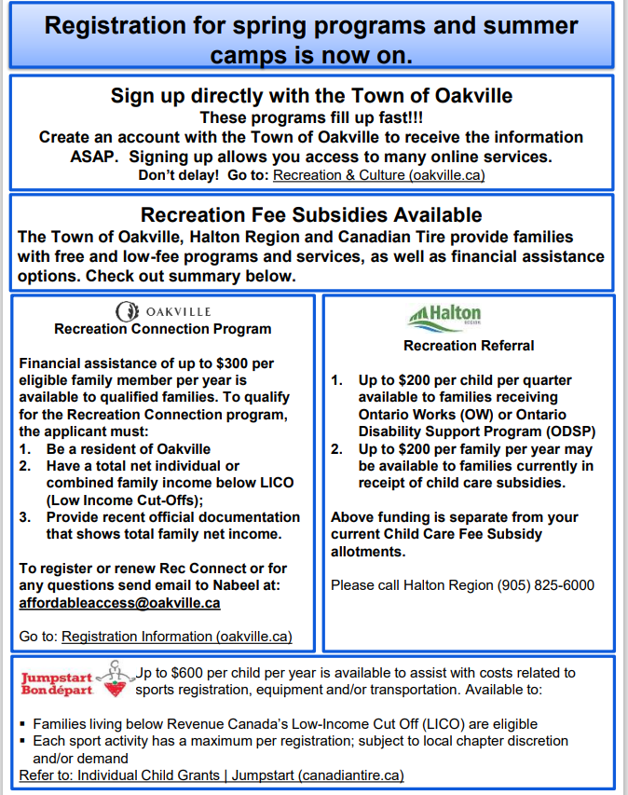
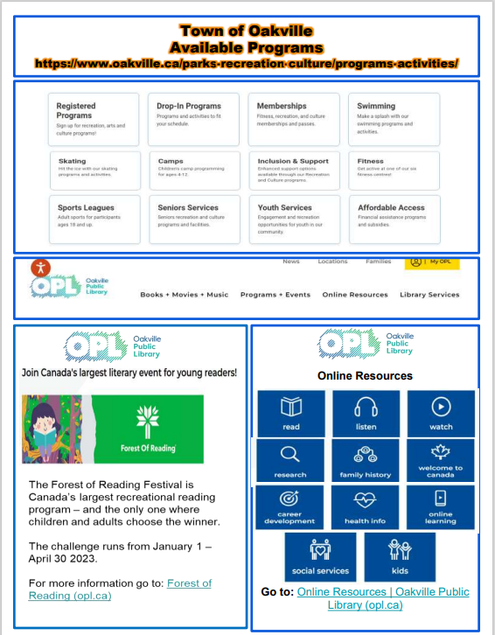

There are simple recreation resources that we can leverage for our home visits and any interactions we have with the families
Notes:
There are simple recreation resources that we can leverage for our home visits and any interactions we have with the families.
We have a recreation sheet we keep updated and current. This is a standard resource for us. .
We periodically invite the town of Oakville rec department come to our food box to help families sign up for their recreational assistance.
We have brochures available. We applied for free day passes to distribute.
There are so many ideas we can use to help the families become aware of what is available and to get connected.
They are also a lot of programs for seniors, to help them to get out and involved in the community.

Slide 51


